Slide 1
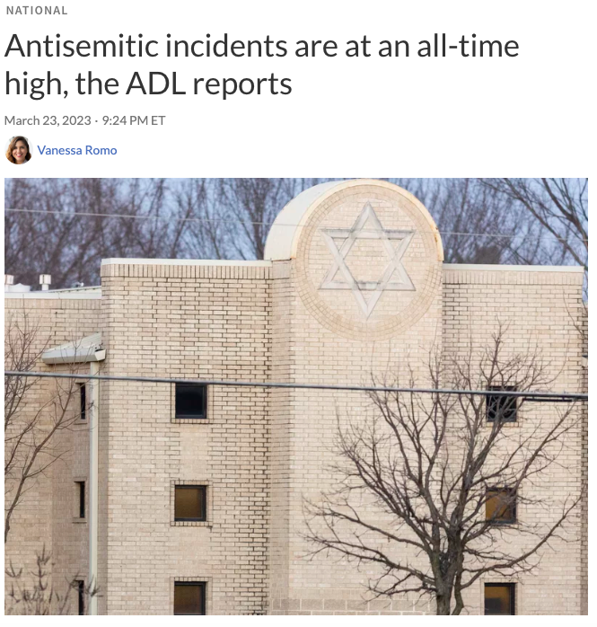
Antisemitism: Threats and Root Causes
Randall Blazak
Coalition Against Hate Crimes

Slide 2
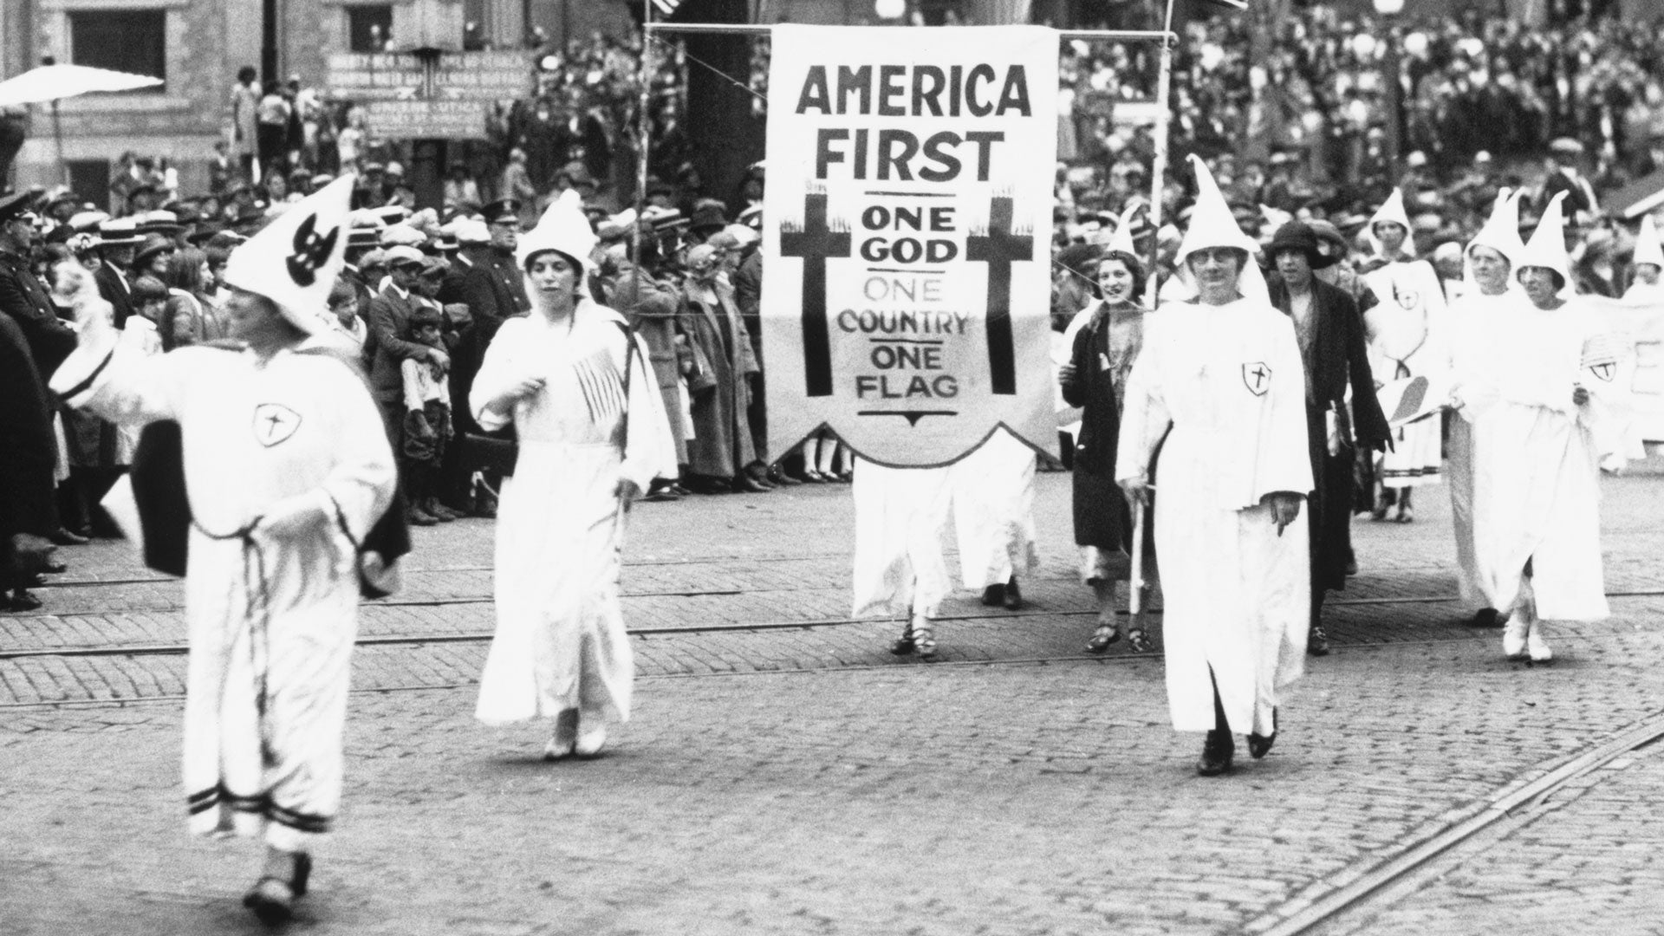
Antisemitism in the 20th Century
White supremacy and the politics of opportunity
Incorporating conspiracy theories about “the Jews”
Timothy McVeigh and the militia war on “ZOG”

Slide 3
The Militia Funnel (Travis McAdam)
Mainstream Conservative Issues
Anti-Government Rhetoric
Conspiracy Theories
ZOG
__________
Revolution

Slide 4
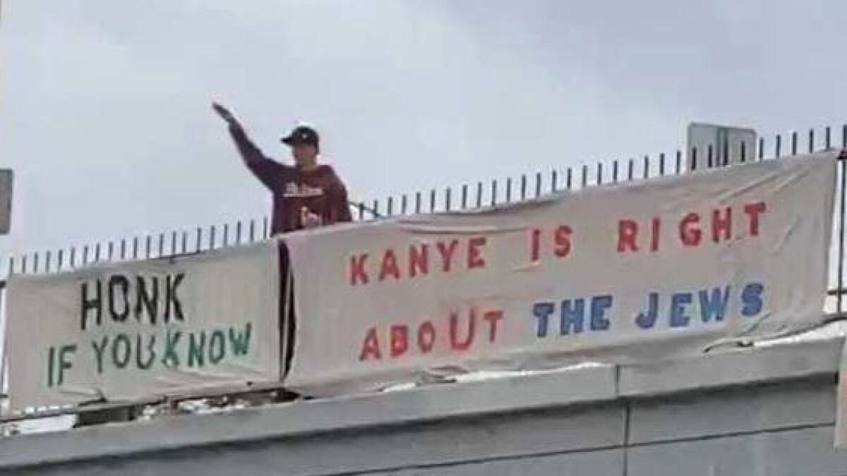
Antisemitism in the 2020s

Slide 5
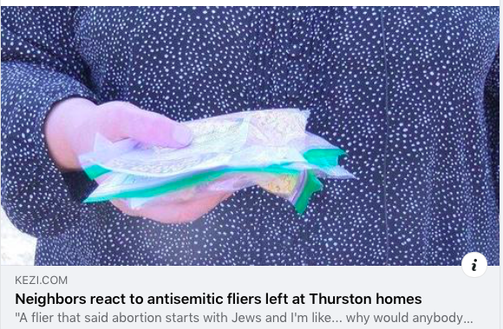
Antisemitism in the 2020s
COVID Conspiracies
Social issues as driven by Soros, etc.
Weaponizing Israel
The Boogaloo

Slide 6
The Militia Funnel (revisited)
Mainstream Conservative Issues + Anti-Lockdown
“The Swamp”
QAnon: Deep State
ZOG
__________
Revolution

Slide 7
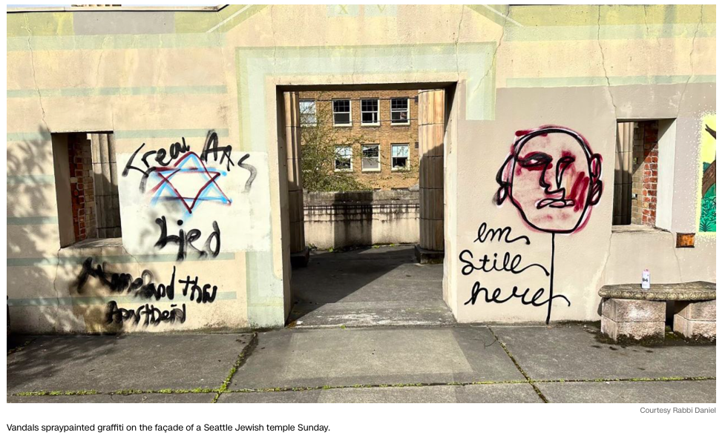
What’s Driving the Surge?
Economic and demographic shifts
Dark web generators
Social media spreaders
Charismatic conspirators
Opportunistic hate groups

Slide 8
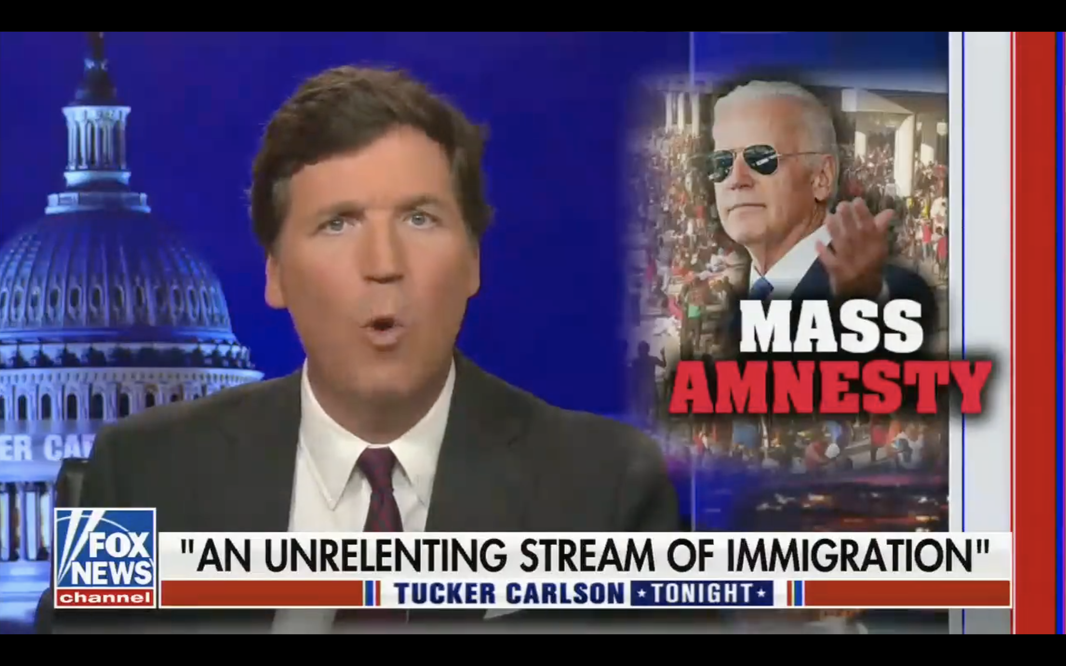
What is the impact of mainstreaming old conspiracy theories?

