Slide 1
CONGREGATION
BETH
ISRAEL
166th Annual Meeting
May 23, 2024 | 15 Iyyar 5784

Slide 2
5784 AT CBI
Our community was a source of strength for one another in a year unlike any other by:
Holding regular community gatherings and Zooms with the CBI Clergy offering support, information, and a safe space to process
Including two gatherings specifically for our college students as some navigate campus unrest
Following Rabbi Michael Z. Cahana’s Israel relief travels
Participating in community-wide discussion, vigils, and responses
Hosting an interfaith luncheon with Sharaka
Providing resources to discuss the news from Israel with young families, tweens, and teens

Slide 3
Our clergy and community are here for you and for continued conversation.
Please reach out to
clergy@bethisrael-pdx.org
if you wish to connect

Slide 4
WE CONTINUED OUR 166 YEAR OLD EFFORTS TOWARDS SOCIAL JUSTICE AND TIKKUN OLAM BY:
Allocating over $7,000 to partners citywide from our Social Action Tribute Funds
Allocating over $38,000 to eleven partner organizations (the Oregon Food Bank, LiftUP, IRCO, Virginia Garcia Memorial Health Center, NARA, Sunshine Division, NE Emergency Food Program, Stone Soup, Urban Gleaners, and our own Community Holiday Dinner) to combat food insecurity via the Robert Peltz (z”l) High Holidays Funds for Food
Raising over $2,500 for Rose Haven at their annual Reigning Roses Walk
Holding a Rev. Dr. Martin Luther King, Jr. Day of Service (even a weeklong ice storm couldn’t stop us) and Mitzvah Day, where participants of all ages in sixteen projects for community partners.
Continuing our work to combat voter suppression with the URJ’s RAC (Religious Action Center) Every Voice, Every Vote initiative
Hosting a Community Holiday Dinner with LiftUP, providing over 300 meals, hand knit hats and scarves, and hygiene kits for those in need
Opening the CBI Campus as warming and cooling shelters for guests of Rose Haven during inclement weather
And continuing our partnerships with and support of organizations including Lift UP, NW Towers Sunday Food Pantry, Interfaith Alliance on Poverty, JFCS, Rose Haven, Blanchet House, Portland Refugee Support Group

Slide 5
SOCIAL ACTION IN ACTION

Slide 6
FINANCIAL HIGHLIGHTS
Year End June 30, 2023 resulted in a $2,095,541 increase of net assets and an operational budget surplus of $198,887 (driven primarily by employee retention tax credits).
A $2,500,000 revolving loan was taken out with The Commerce Bank of Oregon to bridge the cash flow/funding gap between The Jennie donations and construction as well as operational startup losses. We have drawn down $565,000. The amount borrowed will convert to a loan in March 2025.
On the statement of activities, revenue and expenses for The Jennie are included in our March 31 numbers. The program was not included in our operational budget in FY24 and therefore is not in the budget column.
To date, we have raised approximately $2.4 million for The Jennie. Final construction/project estimates are $3.3 million.
We are projecting FY24 membership to exceed budget by approximately $15,000, 1% growth over last year.
Our Back to School Night fundraiser raised a record $364,388 from 64 sponsors and 80 donors participating in our Mitzvah Moment! The fundraiser netted approximately $295,000.
Thanks to several donors, our funds have provided close to $49,000 in Religious School scholarships to 104 students and helped fund $48,000 in camps and trips for 58 kids.

Slide 8
THIS YEAR:
Our community grew by 47 households
With opportunities to connect and thrive at every life phase.
We launched Sages and Stages, our group for members sixty-five and up, who enjoyed social hours, private, curator-led tours of area art museums, and member-led opportunities for gardening, crafting, and more

Slide 9
THIS YEAR:
Brotherhood is back after a Covid hiatus with poker nights, a community dinner, and a Hops game, and more summer fun on the horizon
Congregants connected via CBI Circles, congregant-led groups based on hobbies and passions, with thirteen circles (with interests ranging from yoga to aviation to wine tasting) ready to launch this summer.

Slide 10
OUR IDEA (INCLUSION, DIVERSITY, EQUITY AND ACCESS) COMMITTEE WORKED TO MAKE OUR COMMUNITY MORE WELCOMING AND ACCESSIBLE BY:
Creating an event planning guide to ensure CBI events are as inclusive and accessible as possible
Hosting JDAIM (Jewish Disability Awareness, Acceptance, and Inclusion ) Shabbat
Introducing Accommodation Stations, enabling full participation and comfort at our worship services.
These stations are stocked with resources and supplies such as large print prayer books and noise isolating headphones
Facilitating learning opportunities and trainings for CBI leadership and the broader community
Making improvements for accessibility across our historic campus including high visibility tape, improving doorway thresholds, and ensuring bathroom access.
Establishing all gender bathrooms
Making pronoun stickers available at all CBI events
Working toward a more accessible website

Slide 11
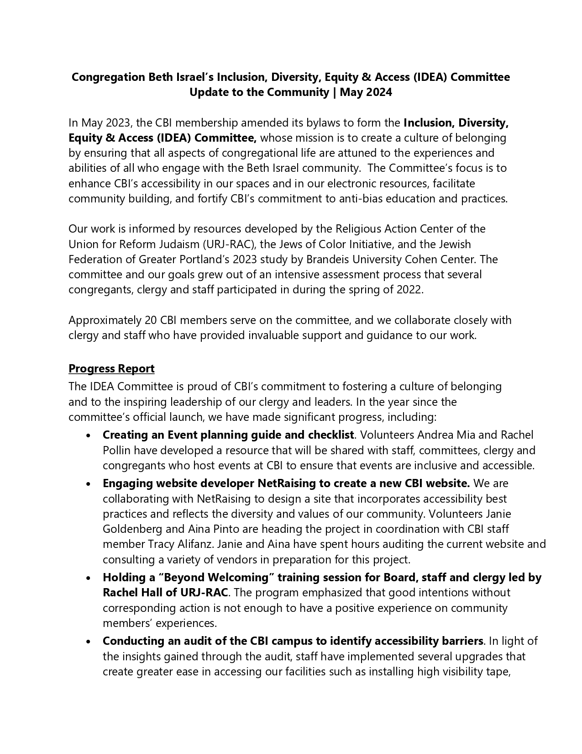
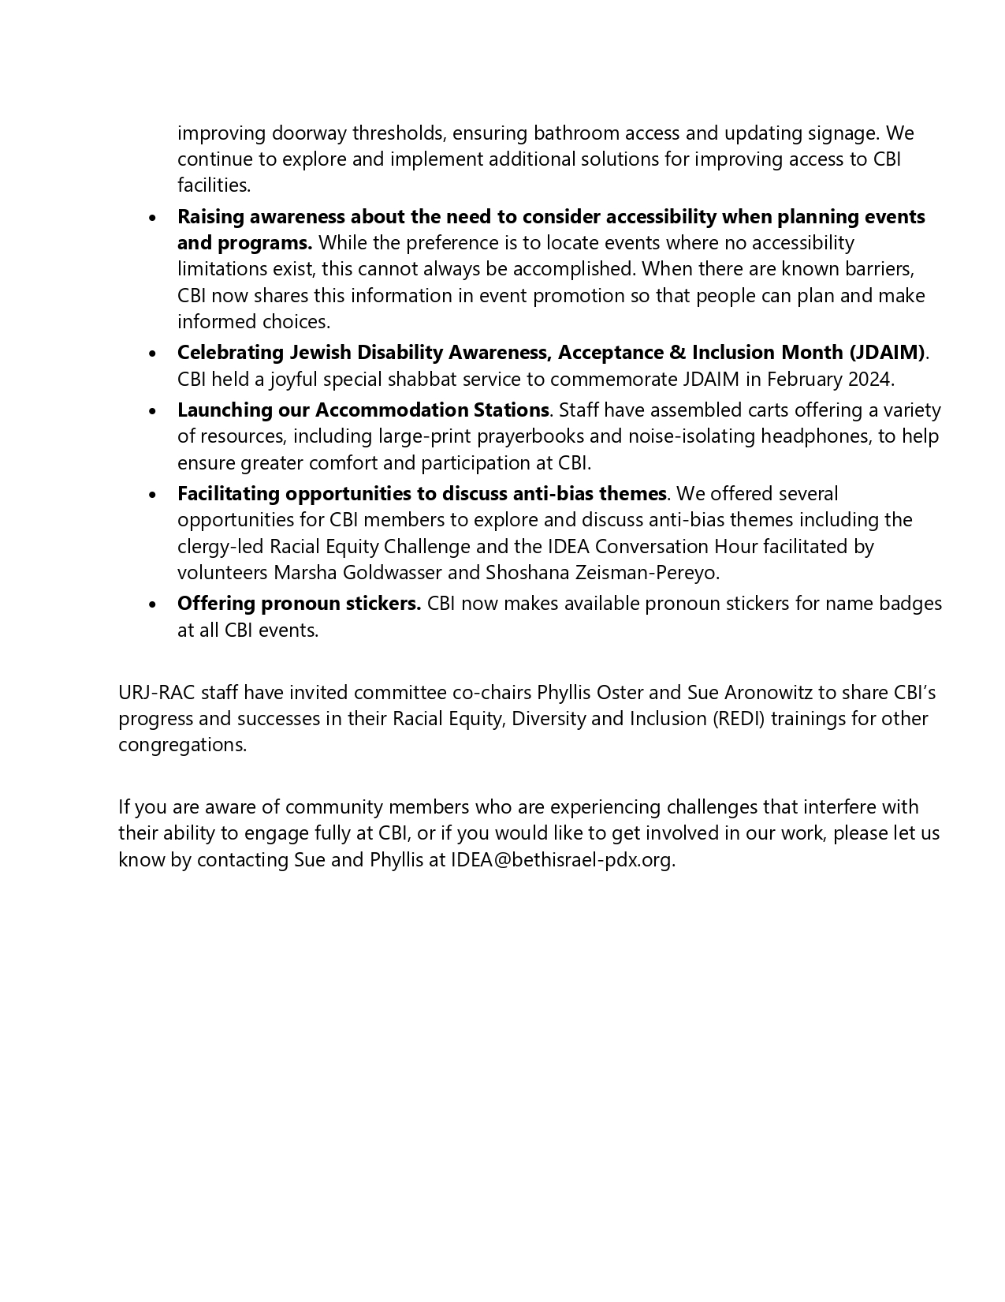

Slide 12
IT WAS A BUSY YEAR FOR OUR
WRJ/BETH ISRAEL SISTERHOOD, WHO:
Allocated over $30,000 to support projects ranging from CBI Artist –in-Residence Kim Schneiderman’ s Shabbat album, Every Season Every Moment, a Passover Seder for JFCS clientele, CBI’s annual Women’s Seder, large print prayer books for the CBI community, and CBI’s forthcoming website accessibility redesign.
Continued their social action on behalf of refugees and our neighbors at Rose Haven
Built community and connection through by leading monthly Shabbat services at Cedar Sinai park, organizing CBI’s annual Sisterhood Shabbat service, co-sponsoring Havdalah at Rose Schnitzer Manor, led by Cantor Green (over 60 participants) , coordinating CBI’s Rosh Hashanah Sweets table, and connecting via book talks, membership schmoozes, Jewish yoga, a “naked lady” clothing swap, a mahjong fundraiser, and much more

Slide 14
WRJ/BETH ISRAEL SISTERHOOD

Slide 15
WE GATHERED FOR HOLIDAY OBSERVANCES WITH:
High Holidays Services, study opportunities, and gathering for all ages including, for the first time, services specifically designed for our pre-B’nei Mitzvah students (in grades four through seven)
Chanukah festivities, including our Chanukah Family Shabbat Celebration, and latkes and poke open house at Rabbi Joseph’s house, Religious School Chanukah Fair, Lama Lo? (CBI’s house band) performance at Leikam Brewery and a Sanctuary for Humanity concert event
Our annual Rev. Dr. Martin Luther King, Jr. Shabbat Service with Hezekiah Watkins

Slide 16
WE GATHERED FOR HOLIDAY OBSERVANCES WITH:
5784, our 1984-themed Purim Schpiel
And, for Passover, the PDX Young Adult Seder with partners Jewish Federation of Portland, Congregation Neveh Shalom, Portland Jewish Connection, Moishe House Pod, and PDX Hillel, a Passover Shabbat Experience, a Passover Fair featuring beloved children’s author Eric Kimmel, a Musical Haggadah, starring our fifth grade class and Oneg! Singers and a concluding Festival Service
And Passover and Purim Fairs for our Religious School students

Slide 17
And there was, of course, Shabbat
With monthly musical Oneg! Shabbat Services
Sisterhood Shabbat
Shabbat on the Plaza (Mark your calendar for this summer’s dates!)
Tot Shabbats (and summertime Tot Shabbats in area parks!)
An Album Release Shabbat, where Artist-in-Residence Kim Schneiderman premiered her new album Every Season, Every Moment, which featured our house band and Oneg! Singers
A Refugee Shabbat Service with HIAS
Black History Shabbat
JDAIM Shabbat
JDC Ukrain Shabbat
and Our upcoming Shabbat Sefarad

Slide 18
WE WELCOMED SHABBAT SPEAKERS, INCLUDING
Musician Avi Hoffman,
Climate Psychologist Renee Lertzman
Amanda Berman of Zioness
and Oseran Lecture with Pulitzer Prizing winning journalist (and CBI congregant) Eli Saslow

Slide 19
SOME OF OUR BIGGEST NEWS IMPACTED OUR LITTLEST COMMUNITY MEMBERS:
This year saw the return of early childhood to the CBI campus with The Jennifer Barnum Luria Early Childhood Center
Under the direction of Bailey Brandt, The Jennie provides play-based, child-led, Reform Jewish early childhood education for students aged six weeks to preschool.
This program will have an eventual capacity of 92 students—and we are well on our way with busy learners age six weeks to preschool!

Slide 20
OUR RELIGIOUS SCHOOL
Enrolled 291 students in preschool through grade twelve
20 of whom made their voices heard in our Oneg! Choir and 5of whom rocked out in our Oneg! Band
32 of whom became B’nei Mitzvah this year
30 of whom had their first jobs as madrichim (teacher’s assistant)
43 of whom broadened their horizons (and bonded with their friends) on social justice-focused teen trips
Los Angeles for our eighth and ninth graders
Washington, D.C. for our tenth graders
Mississippi for our twelfth graders
New York City for our eleventh graders
Always a hit with our teens and their families, these trips help non-Religious School students connect with CBI, as twelve teens who were not enrolled students participated

Slide 21
NEW RELIGIOUS SCHOOL INITIATIVES
THIS YEAR INCLUDED
A weekly learning service for our upper elementary (fourth and fifth grade) students with the CBI Clergy
Online Hebrew learning for our pre-B’nei students
A Musical Haggadah starring our fifth grade students and Oneg! Choir
Purim and Passover Fairs featuring circus arts from JaJa PDX and children’s author Eric Kimmel
You can follow the learning and fun via our new Instagram: @CBIschoolPDX

Slide 22
WE ARE COMMITTED TO LIFELONG LEARNING, WITH:
With an Adult Hebrew class of ten students
With robust Adult Education Programing that explored the cultural impact of the Yiddish and Ladino Languages by bringing prominent speakers to our campus
Weekly online Torah Study with international scholars

Slide 23
We supported all this learning with Back to School Night, our record-breaking fundraiser, which, under the leadership of Michelle Gradow,
Netted $364,388 for educational programming at CBI
(and gave us all a chance to spend a fabulous evening together, and to explore The Jennie)

Slide 24
WE CELEBRATED
TOGETHER, TOO:
In addition to our thirty-two B’nei Mitzvah, we celebrated six weddings
Eight baby namings,
And eight conversion blessings for babies born to gay Israeli dads via gestational surrogacy—something which until very recently was not legal for them at home!
We honored Education Director Ben Sandler’s twenty years of leadership, and established The Ben Sandler Religious Education Support Fund

Slide 25
WE ARE LOOKING AHEAD TO SOME SIGNIFICANT—AND BITTERSWEET—
CHANGES IN THE COMING YEARS:

Slide 26
CANTOR
IDA RAE CAHANA
announced her plans
to retire next June

Slide 27
with
RABBI
MICHAEL Z. CAHANA
to do the same in 2027

Slide 28
Our Board of Trustees unanimously voted to move forward with Rabbi Rachel Joseph and Cantor Rayna Green as our new clergy leaders
Please be sure to join us after this annual meeting for a champagne reception celebrating our CBI clergy, our community’s 166 years together, and of course, the future!

